Slide 1
OUTLINE
MODULE 1: SESSION 05
Abstract Data Type
Array Implementation of List
Finding Position of an element
Inserting an element into the list
Deleting an element from the list
ABSTRACT DATA TYPE
1

Slide 2
ADT - General Concept
9
Problem solving with a computer means processing data
To process data, we need to define the data type and the operation to be performed on the data
The definition of the data type and the definition of the operation to be applied to the data is part of the idea behind an Abstract Data Type (ADT)

Slide 3
ADT - General Concept
10
The user of an ADT needs only to know that a set of operations are available for the data type, but does not need to know how they are applied
Several simple ADTs, such as integer, real, character, pointer and so on, have been implemented and are available for use in most languages

Slide 4
Data Types
11
A data type is characterized by:
🞑 A set of values
🞑 A data representation, which is common to all these values, and
🞑 A set of operations, which can be applied uniformly to all these values

Slide 5
Primitive Data Types
12
Languages like „C‟ provides the following primitive data types:
🞑 boolean
🞑 char, byte, int
🞑 float, double
Each primitive type has:
🞑 A set of values
🞑 A data representation
🞑 A set of operations
These are “set in stone”.

Slide 6
ADT Definition [Wikipedia]
13
In computer science, an abstract data type (ADT) is a mathematical model for a certain class of data structures that have similar behavior.
An abstract data type is defined indirectly, only by the operations that may be performed on it and by mathematical constraints on the effects (and possibly cost) of those operations.

Slide 7
ADT Definition [Wikipedia]
14
An ADT may be implemented by specific data types or
data structures, in many ways and
in many a formal
programming languages; or described in
specification language.
example, an abstract stack could be defined by three operations:
🞑 push, that inserts some data item onto the structure,
🞑 pop, that extracts an item from it, and
🞑 peek, that allows data on top of the structure to be examined without removal.

Slide 8
ADT in Simple Words
16
Definition:
🞑 Is a set of operation
🞑 Mathematical abstraction
🞑 No implementation detail
Example:
🞑 Lists, sets, graphs, stacks are examples of ADT along with their operations

Slide 9
Why ADT?
17
Modularity
🞑 divide program into small functions
🞑 easy to debug and maintain
🞑 easy to modify
🞑 group work
Reuse
🞑 do some operations only once
Easy to change the implementation
🞑 transparent to the program

Slide 10
Implementing an ADT
18
To implement an ADT, you need to choose:
🞑 A data representation
must be able to represent all necessary values of the ADT
should be private
🞑 An algorithm for each of the necessary operation:
must be consistent with the chosen representation
all auxiliary (helper) operations that are not in the contract should be private
Remember: Once other people are using it
🞑 It‟s easy to add functionality

Slide 11
The List ADT
19
The List is an
🞑 Ordered sequence of data items called elements
🞑 A₁, A₂, A₃, …,A_{N} is a list of size N
🞑 size of an empty list is 0
🞑 A_{i+1} succeeds A_{i}
^{🞑 A}i-1
preceeds A_{i}
🞑 Position of A_{i} is i
🞑 First element is A₁ called “head”
🞑 Last element is A_{N} called “tail”

Slide 12
Operations on Lists
20
MakeEmpty
PrintList
Find
FindKth
Insert
Delete
Next
Previous

Slide 13
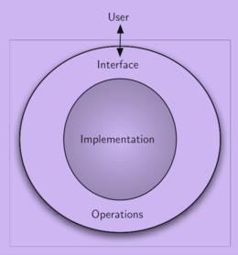
ABSTRACT DATA TYPE
MODULE 1: SESSION 05
18CS302 – DATA STRUCTURES
ABSTRACT DATA TYPE
13

Slide 14
ABSTRACT DATA TYPE
MODULE 1: SESSION 05
18CS302 – DATA STRUCTURES
An Abstract Data Type (ADT) is a logical description of how we view the data and the operations that are allowed without regard to how they will be implemented.
This means that we are concerned only with what the data is representing and not with how it will eventually be constructed.
By providing this level of abstraction, we are creating an encapsulation around the data.
The idea is that by encapsulating the details of the implementation, we are hiding them from the user’s view.
This is called information hiding.
ABSTRACT DATA TYPE
14

Slide 15
ABSTRACT DATA TYPE
MODULE 1: SESSION 05
18CS302 – DATA STRUCTURES
The user interacts with the interface, using the operations that have been specified by the abstract data type.
ADT is the shell that the user interacts with.
The implementation is hidden one level deeper.
The user is not concerned with the details of the implementation.
ABSTRACT DATA TYPE
15

Slide 16
ABSTRACT DATA TYPE
MODULE 1: SESSION 05
18CS302- DATA STRUCTURES
The implementation of an ADT, often referred to as a data structure, will require that we provide a physical view of the data using some collection of programming constructs and primitive data types.
The separation of these two perspectives will allow us to define the complex data models for our problems without giving any indication as to the details of how the model will actually be built. This provides an implementation-independent view of the data.
ABSTRACT DATA TYPE
16

Slide 17
ABSTRACT DATA TYPE
MODULE 1: SESSION 05
18CS302 – DATA STRUCTURES
Since there will usually be many different ways to implement an ADT, this implementation independence allows the programmer to switch the details of the implementation without changing the way the user of the data interacts with it.
The user can remain focused on the problem-solving process.
ABSTRACT DATA TYPE
17

Slide 18
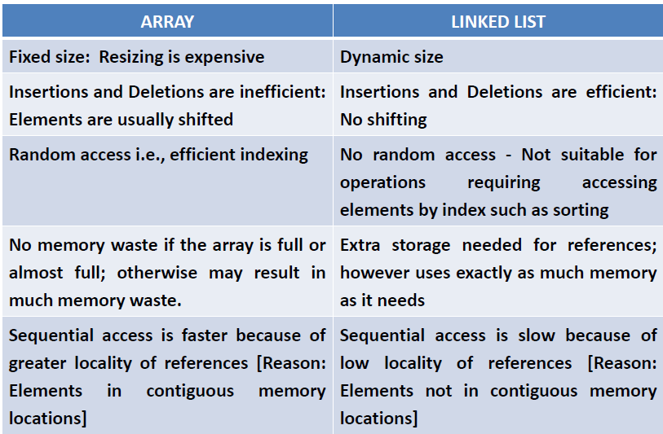
ARRAY VS LINKED LIST
MODULE 1: SESSION 05
18CS302 – DATA STRUCTURES
ABSTRACT DATA TYPE 10

Slide 19
ARRAY IMPLEMENTATION OF LIST
MODULE 1: SESSION 05
18CS302 – DATA STRUCTURES
A list is a collection of elements.
An element can be added anywhere in the list. An element at any location can be removed from the list.
Demerits:
Before inserting an element into the list, all the elements next to the position where it has to be inserted should be moved one position ahead.
Similarly after deleting an element, all the elements after the element deleted, should be moved one position left.
Hence both deletions and insertions are costly in the array implementation of a list.
ABSTRACT DATA TYPE 19

Slide 20
List – An Example
21
The elements of a list are 34, 12, 52, 16, 12
🞑 Find (52) -> 3
🞑 Insert (20, 4) -> 34, 12, 52, 20, 16, 12
🞑 Delete (52) -> 34, 12, 20, 16, 12
🞑 FindKth (3) -> 20

Slide 21
List - Implementation
22
Lists can be implemented using:
🞑 Arrays
🞑 Linked List
🞑 Cursor [Linked List using Arrays]

Slide 22
Arrays
23
Array is a static data structure that represents a collection of fixed number of homogeneous data items or
A fixed-size indexed sequence of elements, all of the same type.
The individual elements are typically stored in consecutive memory locations.
The length of the array is determined when the array is created, and cannot be changed.

Slide 23
Arrays
24
Any component of the array can be inspected or updated by using its index.
🞑 This is an efficient operation
🞑 O(1) = constant time
The array indices may be integers (C, Java) or other discrete data types (Pascal, Ada).
The lower bound may be zero (C, Java), one (Fortran), or chosen by the programmer (Pascal, Ada)

Slide 24
Different Types of Arrays
25
One-dimensional array: only one index is used
Multi-dimensional array: array involving more than one index
Static array: the compiler determines how memory will be allocated for the array
Dynamic array: memory allocation takes place during execution

Slide 25
One Dimensional Static Array
26
Syntax:
🞑 ElementType arrayName [CAPACITY];
🞑 ElementType arrayName [CAPACITY] =
{ initializer_list };
Example in C++:
🞑 int | b | [5];
🞑 int | b | [5] | = | {19, | 68, | 12, | 45, | 72};

Slide 26
Array Output Function
27
void display(int array[],int num_values)
{
for (int I = 0; i<num_values; i++) cout<< array[i] << “ ”;
}

Slide 27
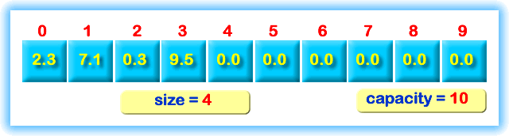
List Implemented Using Array
28

Slide 28
Operations On Lists
29
We‟ll consider only few operations and not all operations on Lists
Let us consider Insert
There are two possibilities:
🞑 Ordered List
🞑 Unordered List

Slide 29
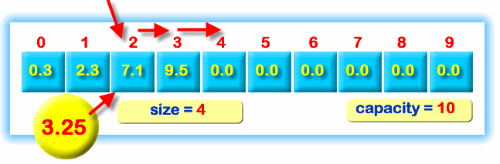
Insertion into an Ordered List
30

Slide 30
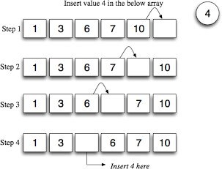
Insertion in Detail
31

Slide 31
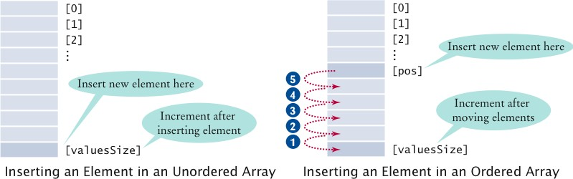
Insertion
32

Slide 32
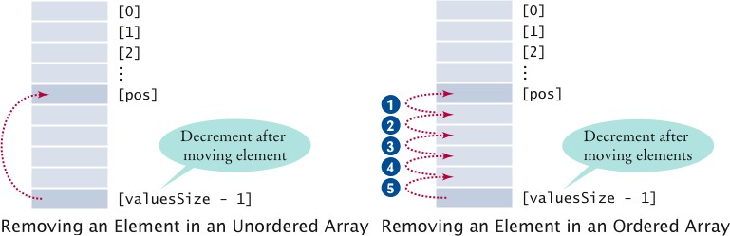
Deletion
33

Slide 33
Find / Search
34
Searching is the process of looking for a specific element in an array
For example, discovering whether a certain score is included in a list of scores.
Searching, like sorting, is a common task in computer programming.
There are many algorithms and data structures devoted to searching.
The most common one is the linear search.

Slide 34
Linear Search
35
The linear search approach compares the given value with each element in the array.
The method continues to do so until the given value matches an element in the list or the list is exhausted without a match being found.
If a match is made, the linear search returns the index of the element in the array that matches the key.
If no match is found, the search returns -1.

Slide 35
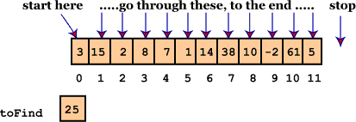
Linear Search
36

Slide 36
Linear Search Function
37
int LinearSearch (int a[], int n, int key)
{
int i;
for(i=0; i<n; i++)
{
if (a[i] == key)
return i;
}
return -1;
}

Slide 37
Using the Function
38
LinearSearch (a,n,item,loc)
Here "a" is an array of the size n.
This algorithm finds the location of the element "item" in the array "a".
If search item is found, it sets loc to the index of the element; otherwise, it sets loc to -1
index=linearsearch(array, num, key)

Slide 38
PrintList Operation
39
int myArray [5] = {19,68,12,45,72};
/* To print all the elements of the array for (int i=0;i<5;i++)
{
printf("%d", myArray[i]);
}

Slide 39
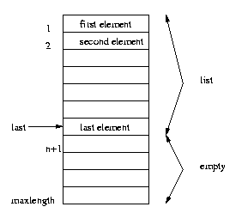
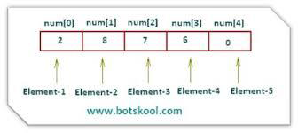
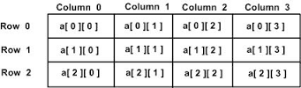
MODULE 1: SESSION 05
18CS302 – DATA STRUCTURES
ABSTRACT DATA TYPE 39

Slide 40
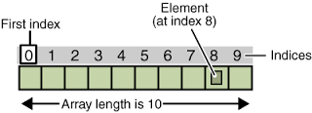
FINDING THE POSITION OF THE ELEMENT
MODULE 1: SESSION 05
18CS302 – DATA STRUCTURES
This function returns the position of the given element.
int search (int arr[ ], int item)
{
int i;
for(i=0;i<n;i++)
{
if(item = arr[i])
return(i+1);
}
}
DABSTRACT DATA TYPE, SKCT 13 13

Slide 41
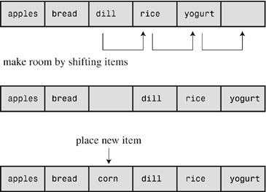
INSERTING AN ELEMENT INTO THE LIST
MODULE 1: SESSION 05
18CS302 – DATA STRUCTURES
This function inserts the given element into the list at the specified position.
• Before adding, the elements found to the right (of the position in which the element is to be added) are moved one position right.

Slide 42
MODULE 1: SESSION 05
18CS302- DATA STRUCTURES
void insert(int arr[], int position, int item)
{
int temp;
if(n==MAX)
{
Error "List overflow"
return;
}
if(position>n) // The position is beyond the range
{
Error " Enter position less than or equal to n”
}
if(position == n) // Inserting the element at the last position
{
arr[n]=item;
n=n+1;
}
temp=n-1; // Inserting the element in the middle position
while(temp>=position-1)
{
arr[temp+1]=arr[temp];
temp--;
}
arr[position-1]=item;
n=n+1; }

Slide 43
DELETING AN ELEMENT FROM THE LIST
MODULE 1: SESSION 05 18CS302- DATA STRUCTURES
This function deletes the specified element.
It searches and finds the position of the element to be deleted.
Once deleted, the elements found to the right (of the element deleted) are moved one position left.

Slide 44
MODULE 1: SESSION 05
18CS302 – DATA STRUCTURES
void delete(int arr[])
{
int temp, position, item;
if(n==0) // The list is empty
{
Error "List underflows";
}
if(item == arr[n-1]) // The element is the last element
{
n=n-1;
}
Position =search (item); // search(item) returns the position of the item
if(position==-1)
{
Error ”Element not present in the array"
}
temp=position-1; // The element is in the middle of the array
while(temp<n-1)
{
arr[temp]=arr[temp+1];
temp++;
}
n=n-1; }

Slide 45
POINTS TO PONDER:
MODULE 1: SESSION 05
18CS302 – DATA STRUCTURES
An Abstract Data Type (ADT) is a logical description of how we view the data and the operations that are allowed.
ADT is the shell that the user interacts with.
A list is a collection of elements.
An element can be added anywhere in the list.
An element at any location can be removed from
the list.

Slide 46
MODULE 1: SESSION 05
18CS302 – DATA STRUCTURES
KEY TERMS
Abstract Data Type
List
Insertion
Deletion

